Slide 1
Computer Architecture Experiment
Topic 8. Cache Design

Slide 2
Outline
Experiment Purpose
Experiment Task
Basic Principle
Operating Procedures
Precaution
Checkpoints

Slide 3
Experiment Purpose
Understand Cache Line.
Understand the principle of Cache Management Unit (CMU) and State Machine of CMU.
Master the design methods of CMU.
Master the design methods of Cache Line.
master verification methods of Cache Line.

Slide 4
Experiment Task
Design of Cache Line and CMU.
Verify the Cache Line and CMU.
Observe the Waveform of Simulation.

Slide 5
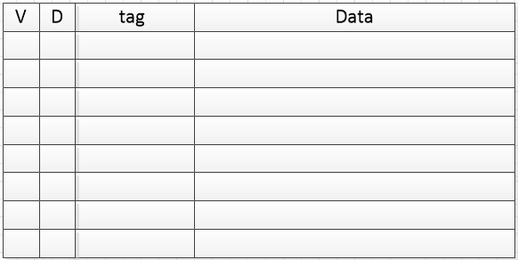
Cache Line

Slide 6

Cache Mode
Direct Map
Write Back
Write Allocate

Slide 7
Address
Bytes of word = 4, WORD_BYTES_WIDTH = 2
Words of line = 4, LINE_WORDS_WIDTH = 2
Tag bits = 22
Address bits = 32
LINE_INDEX_WIDTH = ADDR_BITS - TAG_BITS - LINE_WORDS_WIDTH - WORD_BYTES_WIDTH = ?
Line Number = ?
Notes:
6
2^6 = 32

Slide 8
Cache Line Memory
reg [LINE_NUM-1:0] inner_valid = 0;
reg [LINE_NUM-1:0] inner_dirty = 0;
reg [TAG_BITS-1:0] inner_tag [0:LINE_NUM-1];
reg [WORD_BITS-1:0] inner_data [0:LINE_NUM*LINE_WORDS-1];

Slide 9
Input and output Signals of Cache Line
module cache (
input wire clk, // clock
input wire rst, // reset
input wire [ADDR_BITS-1:0] addr, // address
input wire store, // set valid to 1 and reset dirty to 0
input wire edit, // set dirty to 1
input wire invalid, // reset valid to 0
input wire [WORD_BITS-1:0] din, // data write in
output wire hit, // hit or not
output reg [WORD_BITS-1:0] dout, // data read out
output reg valid, // valid bit
output reg dirty, // dirty bit
output reg [TAG_BITS-1:0] tag // tag bits
);

Slide 10
Read and Write Cache
dout <= inner_data[addr[ADDR_BITS-TAG_BITS-1:WORD_BYTES_WIDTH]];
if ( ???|| ???)
inner_data[addr[ADDR_BITS-TAG_BITS-1:WORD_BYTES_WIDTH]] <= din;

Slide 11
Dirty, Valid, tag of Cache
invalid
inner_valid[addr[ADDR_BITS-TAG_BITS-1:LINE_WORDS_WIDTH+WORD_BYTES_WIDTH]] <=?
inner_dirty[addr[ADDR_BITS-TAG_BITS-1:LINE_WORDS_WIDTH+WORD_BYTES_WIDTH]] <= ?
load
inner_valid[addr[ADDR_BITS-TAG_BITS-1:LINE_WORDS_WIDTH+WORD_BYTES_WIDTH]] <=?
inner_dirty[addr[ADDR_BITS-TAG_BITS-1:LINE_WORDS_WIDTH+WORD_BYTES_WIDTH]] <=?
inner_tag[addr[ADDR_BITS-TAG_BITS-1:LINE_WORDS_WIDTH+WORD_BYTES_WIDTH]] <=?
edit
inner_dirty[addr[ADDR_BITS-TAG_BITS-1:LINE_WORDS_WIDTH+WORD_BYTES_WIDTH]] <=?
inner_tag[addr[ADDR_BITS-TAG_BITS-1:LINE_WORDS_WIDTH+WORD_BYTES_WIDTH]] <=?

Slide 12
output of Dirty, Valid, tag, hit
valid <= inner_valid[addr[ADDR_BITS-TAG_BITS-1:LINE_WORDS_WIDTH+WORD_BYTES_WIDTH]]
dirty <= inner_dirty[addr[ADDR_BITS-TAG_BITS-1:LINE_WORDS_WIDTH+WORD_BYTES_WIDTH]]
tag <= inner_tag[addr[ADDR_BITS-TAG_BITS-1:LINE_WORDS_WIDTH+WORD_BYTES_WIDTH]]
hit = ?? & ??

Slide 13
Simulation Example
#210 load = 1; din = 32'h11111111; addr = 32'h00000000;
#20 addr = 32'h00000004;
#20 addr = 32'h000000A8;
#20 addr = 32'h0000001C;
#20 load = 0; addr = 32'h000000B4; din = 0;
#100 edit = 1; din = 32'h22222222; addr = 32'h00000008;
#100 edit = 0; din = 0; addr = 0;
initial forever #10 clk = ~clk;

Slide 14
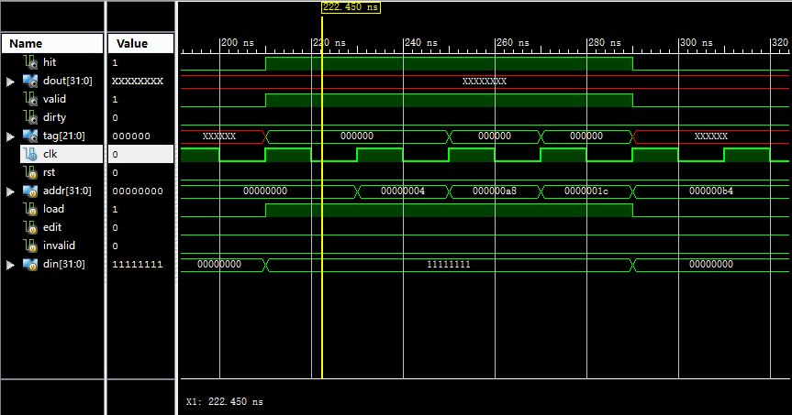
Simulation Example

Slide 15
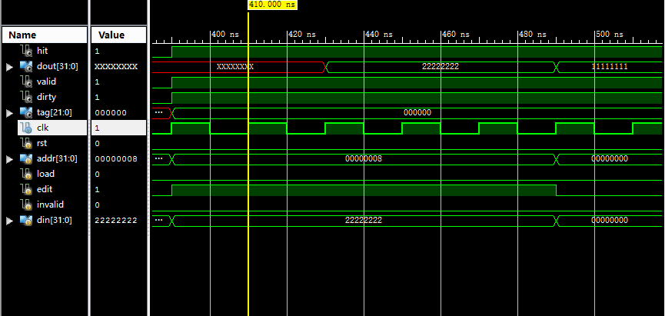
Simulation Example

Slide 16
Simulation
Write Simulation Code yourself
cache initialization
read
miss
hit
write
miss
hit

Slide 17
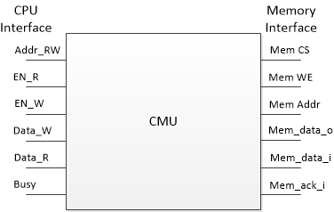
Cache Management Unit

Slide 18
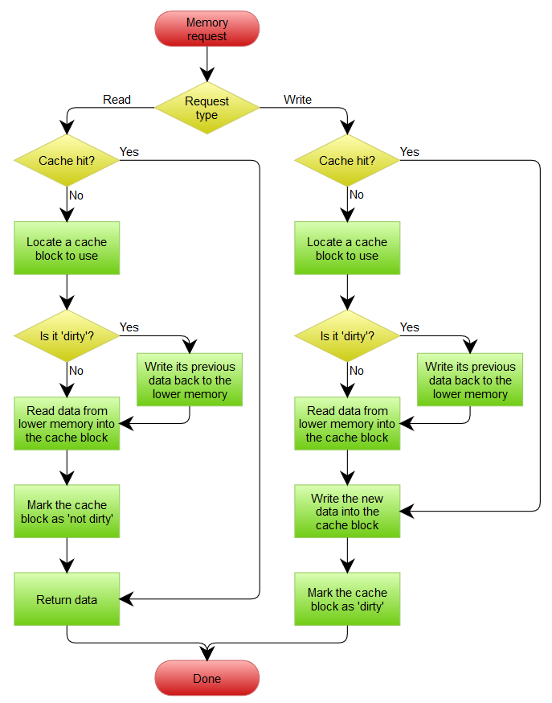
Cache Operation Flow
Read (Hit/Miss)
Write (Hit/Miss)
Replace (Clean/Dirty)

Slide 19
Cache Management State Machine
Read/Write Hit
Writing Back
Miss & Dirty
S_IDLE
S_BACK
S_BACK_WAIT
Miss & Clean
S_FILL
S_FILL_WAIT
Reading Allocate
Notes:
S_IDLE：空闲状态，不进行Memory操作。
S_BACK：将数据写回到Memory，由计数器控制直到整个Cache Line 全部写回。
S_BACK_WAIT：等待一个时钟，需要释放对Memory的片选以准备下次操作。
S_FILL：从Memory读取数据，由计数器控制直到整个Cache Line 全部读取完毕。
S_FILL_WAIT：等待一个时钟，保证最后一个数据成功写入Cache。

Slide 20
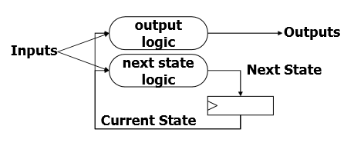
State Machine
Next State Logic
State assignment
Output

Slide 21
Next logic (1)
S_IDLE: begin
if (en_r || en_w) begin
if (cache_hit)
next_state = ???;
else if (cache_valid && cache_dirty)
next_state = ???;
else
next_state = ???;
end
end
S_BACK: begin
if (mem_ack_i)
next_word_count = word_count + 1'h1;
else
next_word_count = word_count;
if (mem_ack_i && word_count == {LINE_WORDS_WIDTH{1'b1}})
next_state = ???;
else
next_state = ???;
end

Slide 22
Next logic (2)
S_BACK_WAIT: begin
next_word_count = 0;
next_state = ???;
end
S_FILL: begin
if (mem_ack_i)
next_word_count = word_count + 1'h1;
else
next_word_count = word_count;
if (mem_ack_i && word_count == {LINE_WORDS_WIDTH{1'b1}})
next_state = ???;
else
next_state = ???;
end
S_FILL_WAIT: begin
next_word_count <= 0;
next_state <= ???;
end

Slide 23
Perform State Assignment
always @(posedge clk) begin
if (rst) begin
state <= 0;
word_count <= 0;
end
else begin
state <= next_state;
word_count <= next_word_count;
end
end

Slide 24
Output (1)
case (next_state)
S_IDLE: begin
cache_addr = addr_rw;
cache_edit = en_w;
cache_din = data_w;
end
S_BACK, S_BACK_WAIT: begin
cache_addr = {addr_rw[31:LINE_WORDS_WIDTH+2], next_word_count, 2'b00};
end
S_FILL, S_FILL_WAIT: begin
cache_addr = {addr_rw[31:LINE_WORDS_WIDTH+2], word_count_buf, 2'b00};
cache_din = mem_data_syn;
cache_store = mem_ack_syn;
end
endcase

Slide 25
Output (2)
case (next_state)
S_IDLE, S_BACK_WAIT, S_FILL_WAIT: begin
mem_cs_o <= 0;
mem_we_o <= 0;
mem_addr_o <= 0;
end
S_BACK: begin
mem_cs_o <= 1;
mem_we_o <= 1;
mem_addr_o <= {cache_tag, addr_rw[31-TAG_BITS:LINE_WORDS_WIDTH+2], next_word_count, 2'b00};
end
S_FILL: begin
mem_cs_o <= 1;
mem_we_o <= 0;
mem_addr_o <= {addr_rw[31:LINE_WORDS_WIDTH+2], next_word_count, 2'b00};
end
endcase

Slide 26
Simulation (1)
module inst (
input wire clk,
input wire rst,
input wire [3:0] index, // instruction index
output wire valid, // stop running if valid is 0
output wire write, // write enable signal for cache
output wire [31:0] addr // address for cache
);
reg [33:0] data [0:7];
initial begin // clock cycles are only for reference
data[0] = 34'h200000004; // read miss 1+17
data[1] = 34'h300000018; // write miss 1+17
data[2] = 34'h200000008; // read hit 1
data[3] = 34'h300000014; // write hit 1
data[4] = 34'h210000004; // read & clean replace 1+17
data[5] = 34'h310000018; // write & dirty replace 1+17*2
data[6] = 34'h310000008; // write hit 1
data[7] = 34'h0; // end total: 92
end
assign
valid = data[index][33],
write = data[index][32],
addr = data[index][31:0];
endmodule

Slide 27
Simulation (2)
always @(posedge clk) begin
if (rst)
index <= 0;
else if (valid && ~stall)
index <= index + 1'h1;
end
// ram
wire mem_cs;
wire mem_we;
wire [31:0] mem_addr;
wire [31:0] mem_din;
wire [31:0] mem_dout;
wire mem_ack;
data_ram #(
.ADDR_WIDTH(5),
.CLK_DELAY(3)
) RAM (
.clk(clk),
.rst(rst),
.addr({26'b0, mem_addr[5:0]}),
.cs(mem_cs),
.we(mem_we),
.din(mem_din),
.dout(mem_dout),
.stall(),
.ack(mem_ack)
);
`timescale 1ns / 1ps
module top (
input wire clk,
input wire rst,
output reg [7:0] clk_count = 0,
output reg [7:0] inst_count = 0,
output reg [7:0] hit_count = 0
);
// instruction
reg [3:0] index = 0;
wire valid;
wire write;
wire [31:0] addr;
wire stall;
inst INST (
.clk(clk),
.rst(rst),
.index(index),
.valid(valid),
.write(write),
.addr(addr)
);

Slide 28
Simulation (3)
// cache
cmu CMU (
.clk(clk),
.rst(rst),
.addr_rw(addr),
.en_r(~write),
.data_r(),
.en_w(write),
.data_w({16'h5678, clk_count, inst_count}),
.stall(stall),
.mem_cs_o(mem_cs),
.mem_we_o(mem_we),
.mem_addr_o(mem_addr),
.mem_data_i(mem_dout),
.mem_data_o(mem_din),
.mem_ack_i(mem_ack)
);
// counter
reg stall_prev;
always @(posedge clk) begin
if (rst)
stall_prev <= 0;
else
stall_prev <= stall;
end
always @(posedge clk) begin
if (rst) begin
clk_count <= 0; // 时钟计数
inst_count <= 0; // 指令计数
hit_count <= 0; // 命中计数
end
else if (valid) begin
clk_count <= clk_count + 1'h1;
inst_count <= index + 1'h1;
if (~stall_prev && ~stall)
hit_count <= hit_count + 1'h1;
end
end
endmodule

Slide 29
Simulation (4)
module sim_top;
// Inputs
reg clk;
reg rst;
// Outputs
wire [7:0] clk_count;
wire [7:0] inst_count;
wire [7:0] hit_count;
// Instantiate the Unit Under Test (UUT)
top uut (
.clk(clk),
.rst(rst),
.clk_count(clk_count),
.inst_count(inst_count),
.hit_count(hit_count)
);
initial begin
// Initialize Inputs
clk = 0;
rst = 1;
// Wait 100 ns for global reset to finish
#95 rst = 0;
// Add stimulus here
end
initial forever #10 clk = ~clk;
endmodule

Slide 30
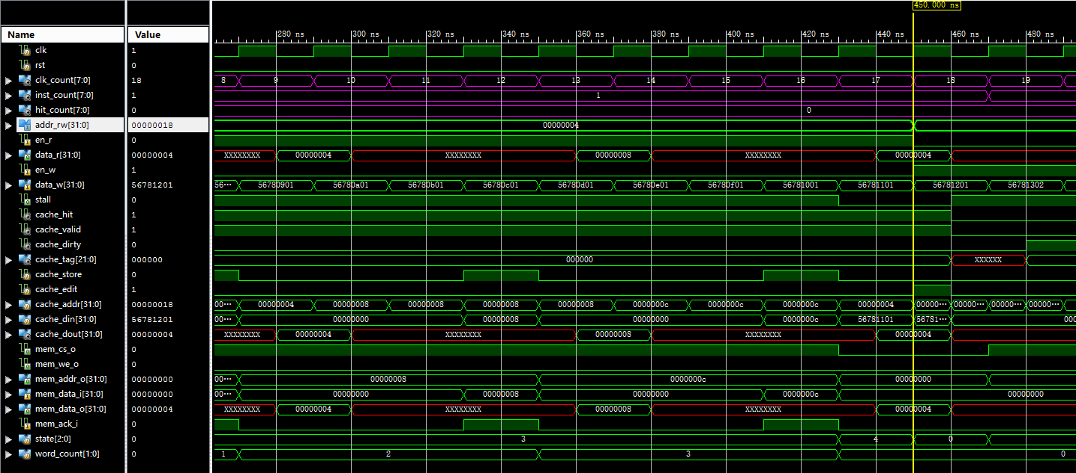
Result (1)
Read miss at 0x00000004

Slide 31
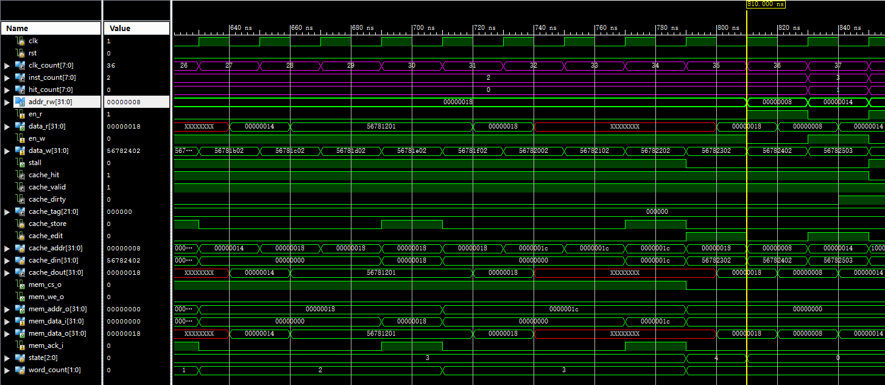
Result (2)
Write miss at 0x00000018
Read hit at 0x00000008
Write hit at 0x00000014

Slide 32
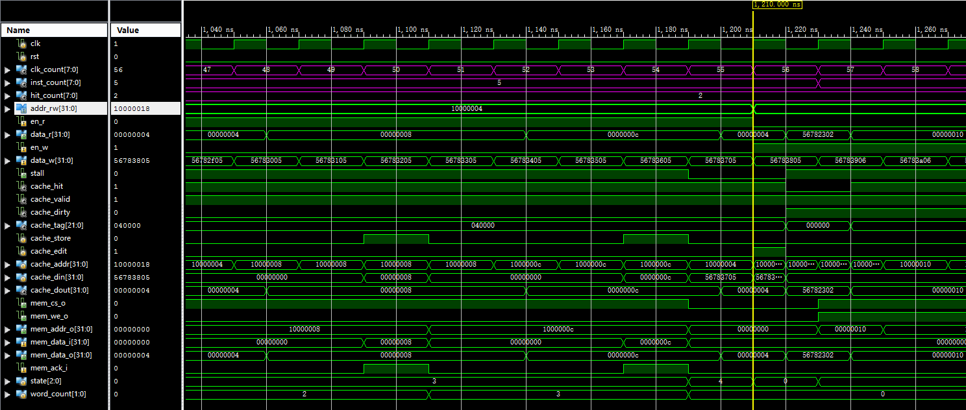
Result (3)
Read & clean replace at 0x10000004

Slide 33
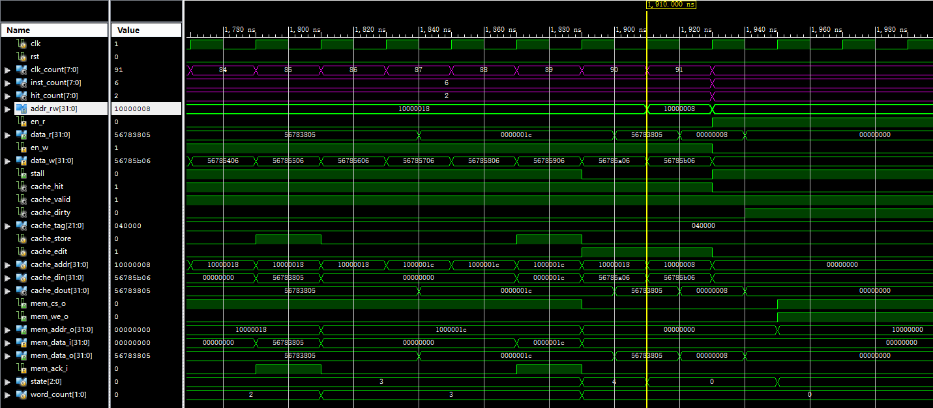
Result (4)
Write & dirty replace at 0x10000018
Write hit at 0x10000008

Slide 34
Performance Analysis
Miss Penalty
When clean, MP = 17
When dirty, MP = 34
Result
CLK_COUNT = 92
INST_COUNT = 7
HIT_COUNT = 3

Slide 35
Checkpoints
CP1:
Waveform Simulation of Cache Line.
CP2:
Waveform Simulation of CMU.

Slide 36
Thanks!

